Slide 1
CHART PATTERNS

Slide 2
Meaning of Chart Patterns
Chart patterns is graphical presentation of price movement by using a series of trend lines /curves.

Slide 3
Types of Chart patterns
Support & Resistance Patterns
Continuation Patterns
Reversal Patterns

Slide 4
Support & Resistance Patterns
Support & Resistance are price levels at which the downtrend or uptrend in price movements is reversed.

Slide 5
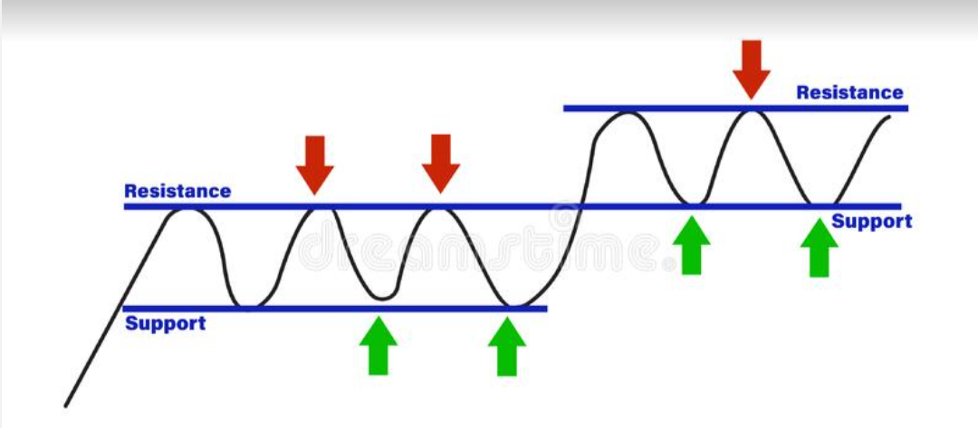
Support & Resistance level

Slide 6
Continuation Patterns
Continuation Patterns are price patterns that show a temporary interruption of an existing trend.
Types of Continuation Patterns:
Triangle Pattern
Flag Pattern
Pennant Pattern

Slide 7
Triangles patterns
Types of Triangles:
Symmetrical Triangle
Ascending Triangle
Descending Triangle

Slide 8
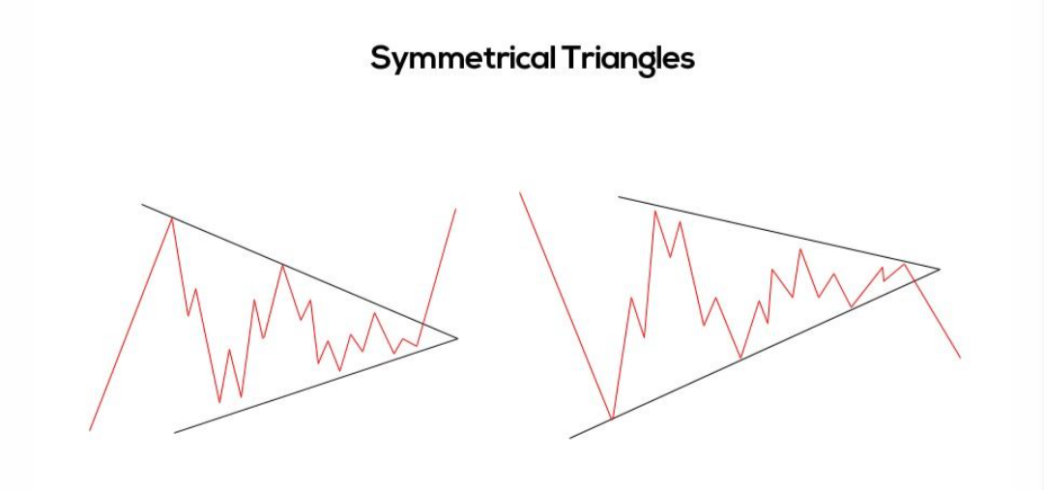
Symmetrical Triangle
Symmetrical Triangle is a consolidation chart pattern that occurs when the price action trades sideways.

Slide 9
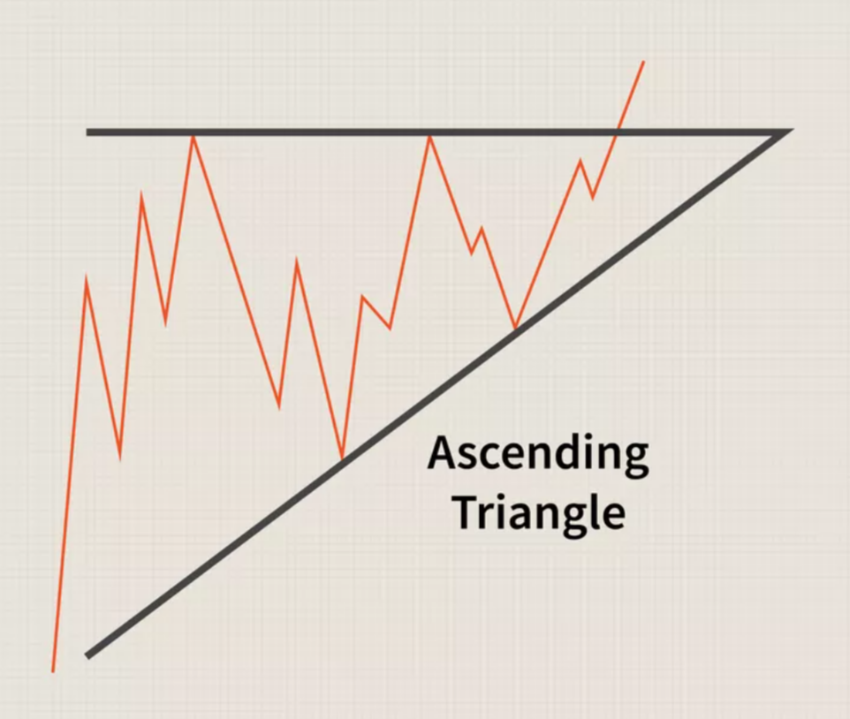
Ascending Triangle
It is typically breaks out in the same direction as the trend was going just prior to where the triangle formed.

Slide 10
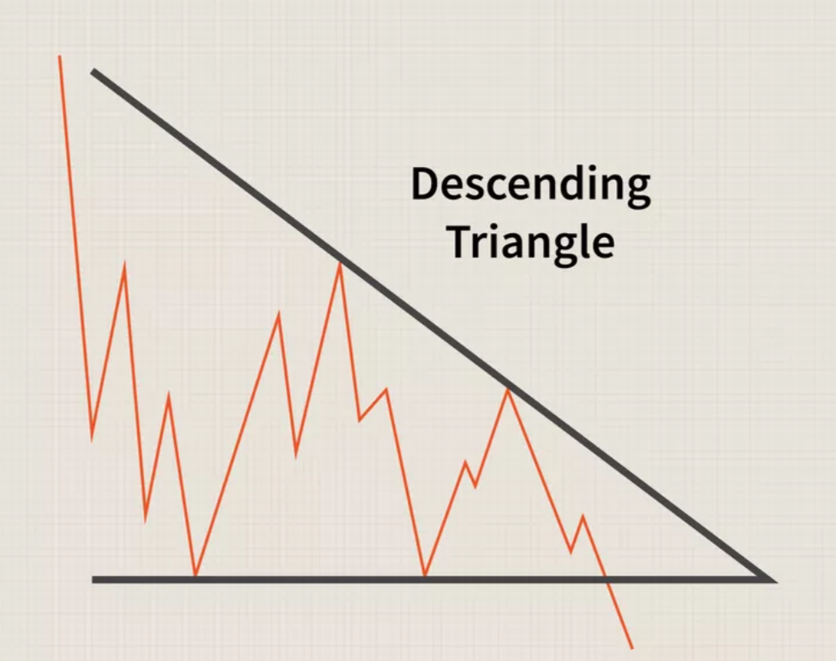
Descending Triangle
It shows traders that the demand for an asset is weakening as the price breaks below the low support levels with downward movement

Slide 11
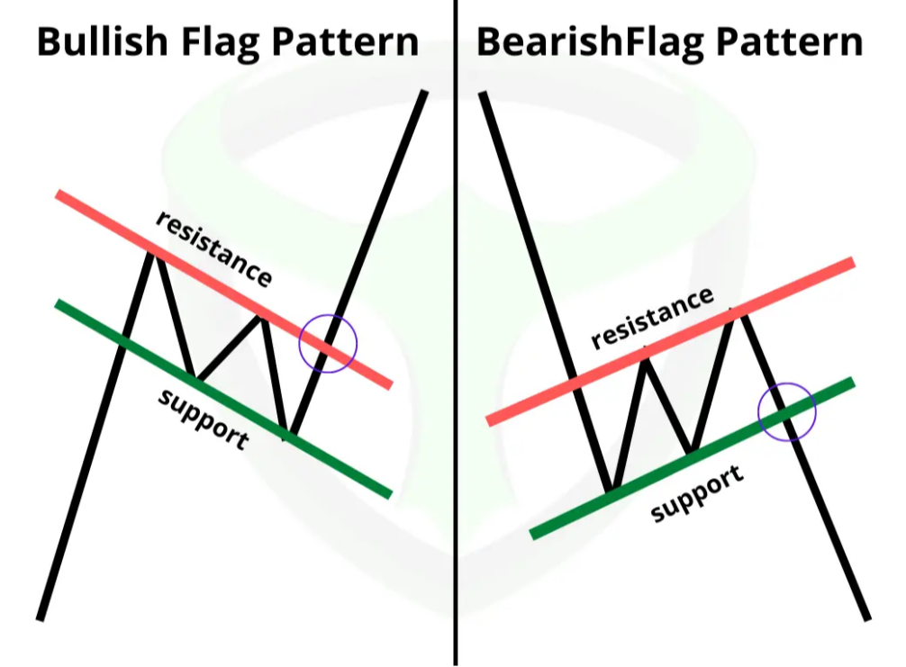
Flags
Flag Chart pattern is formed when the market consolidates in a narrow range after a sharp move.

Slide 12
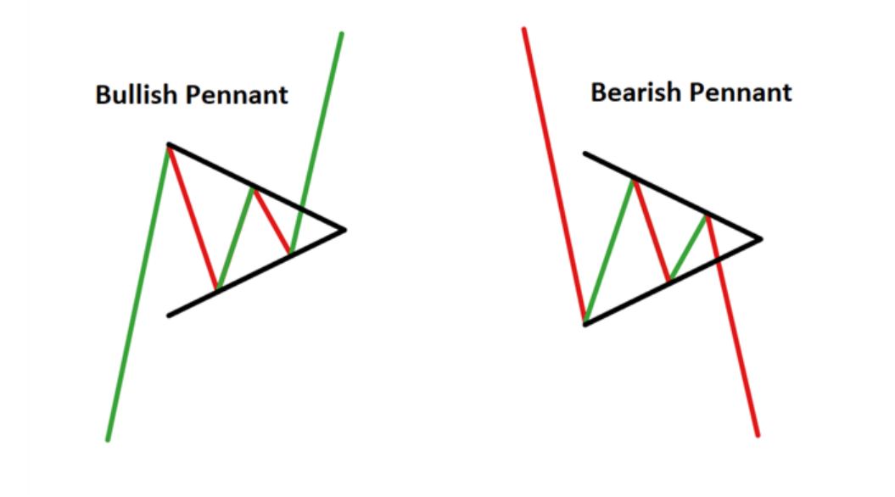
Pennant
It is formed when there is a large movement in a security and it is followed by a consolidation period with converging trend lines.

Slide 13
Reversal Pattern
Price movements exhibit uptrends & downtrends. The trends reverse direction after a period of time.
Types of Reversal Pattern:
Double Top & Double Bottom Pattern
Head & Shoulder Pattern
Inverse Head & shoulder Pattern

Slide 14
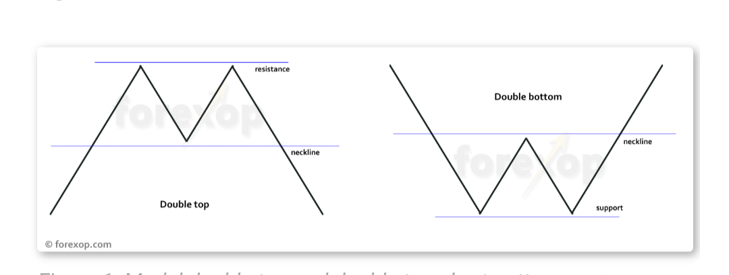
Double Top Pattern & Double Bottom Pattern

Slide 15
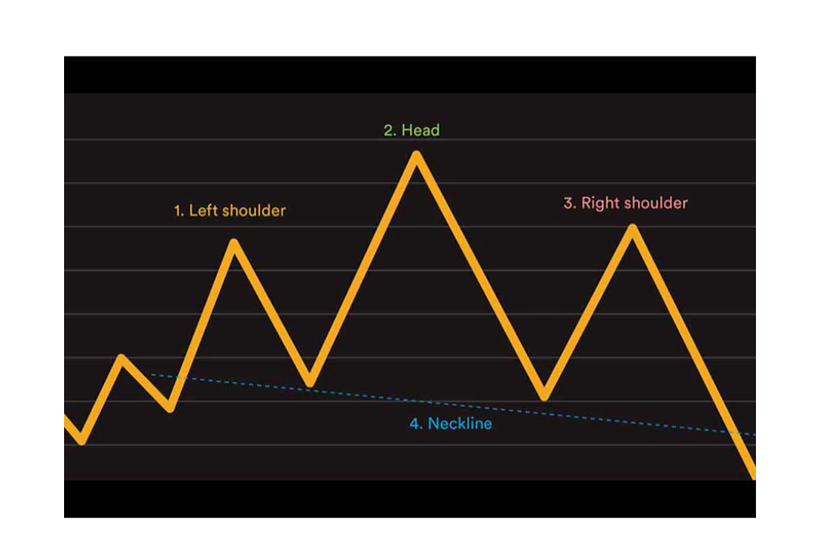
Head & shoulder pattern

Slide 16
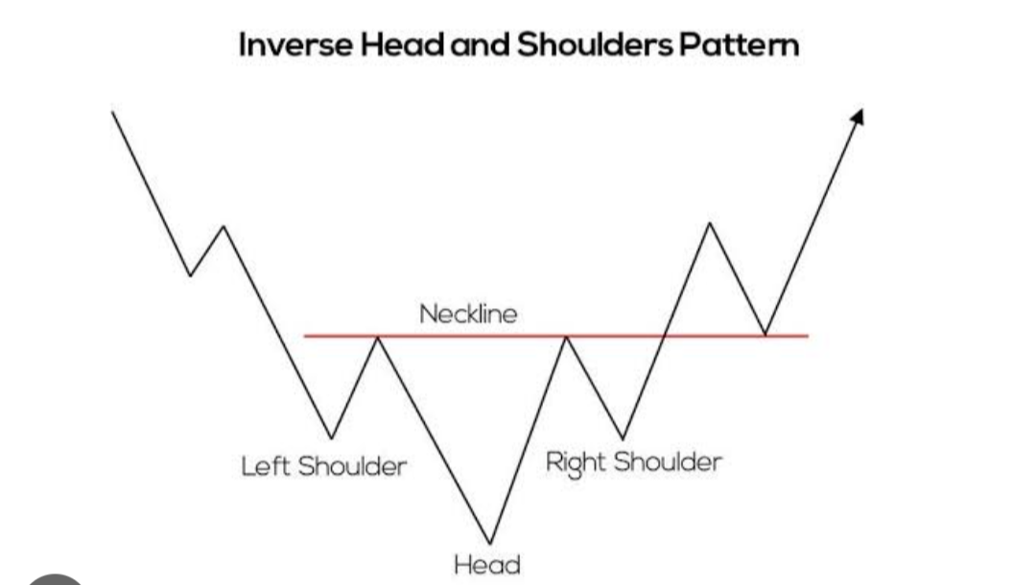
Inverse Head & Shoulder Pattern

Slide 17
THANK YOU

